Slide 1

ICPC Assiut Community Juniors 1 Level

Slide 2
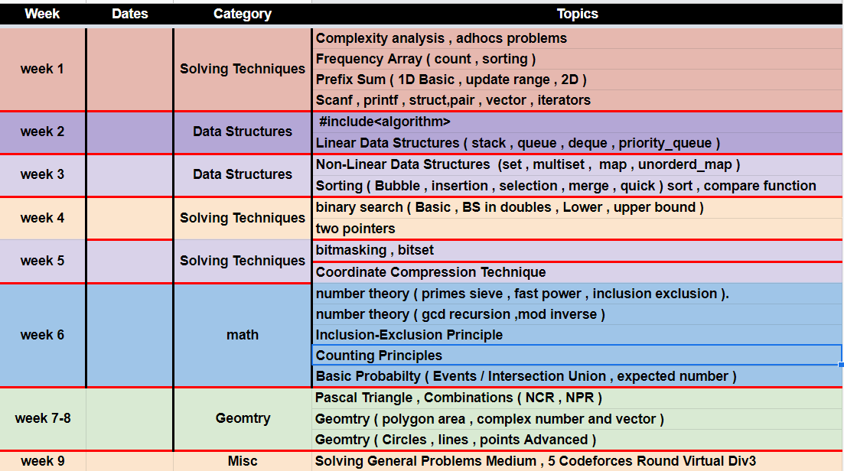
Plan TimeLine , Content

Slide 3
Tips to be Competitive
Type Code Faster
Quickly identify problem type
Do algorithms analysis.
Test Idea fast
Test Code fast.
Practice and Practice and Practice.
Up solve up solve up solve up solve.
Put Strategy in
Contest , calculate contest penalty
Practice

Slide 4

Strategy in solving a problem
Story (statement ), Input and output , samples
Notes.
Time , Memory .

Slide 5
WR ,TLE in Problem
Improve solution make better solution (optimize).
Create Tricky test case to find bug (Check overflow).
Read Problem Statement again and ensure that you understand will.
Leave Problem.

Slide 6
RTE in Problem
Check size of Array
Check divide by 0

Slide 7
Online Judges Registering
Codeforces
Atcoder
UVA
SPOJ
CS academy
HackerRank
Codechef
Leetcode
Join all contests ( especially CF , Atcoder )

Slide 8
Algorithm Complexity
Big O notation
Log , polynomial , cubic , factorial , linear
complexity maximum N
O(log(n)) 10^18
O(N) 10^8
O(N log N) ( 4 * 10^ 7 )
O(N^2) 10^4
O(N^3) 500
O(N^4) 90
O(2^N) 20
O(N!) 11

Slide 9


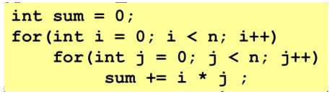

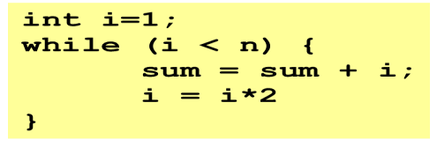



ETERMINING COMPLEXITY OF CODE STRUCTURES

Slide 10
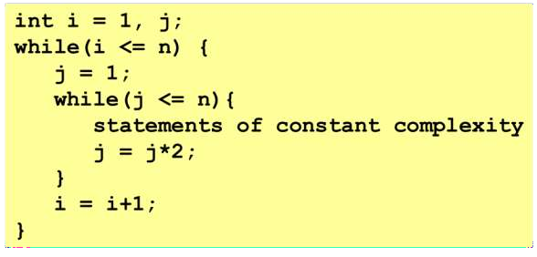

ETERMINING COMPLEXITY OF CODE STRUCTURES

Slide 11
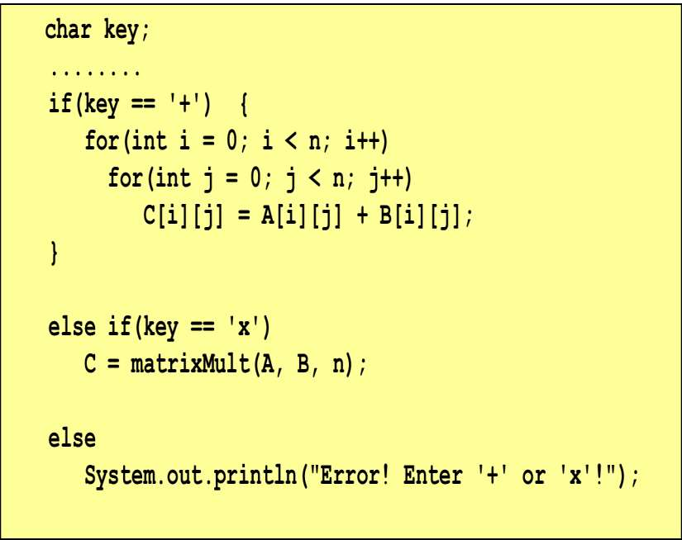







ETERMINING COMPLEXITY OF CODE STRUCTURES

Slide 12

Now It Is Your turn ^^

Slide 13
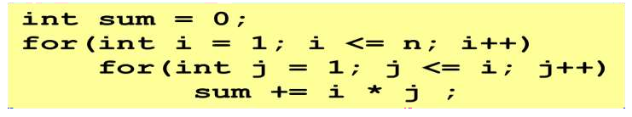
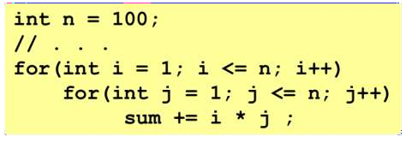
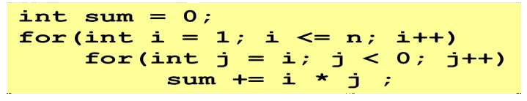
ETERMINING COMPLEXITY OF CODE STRUCTURES

Slide 14
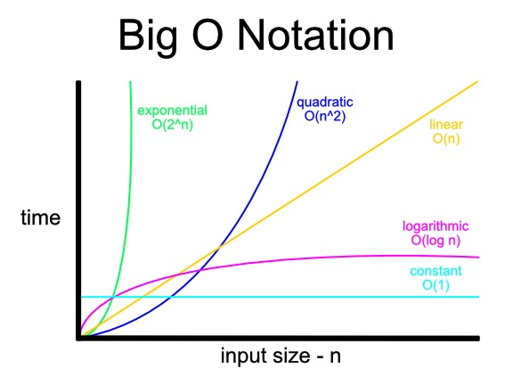
This graph illustrates the relation between input and it’s time complexity:

Slide 15
Frequency Array
When Use it ?
Count every number in array.
Count every char
Visit array
Count distinct numbers.
Sort array problem
Solve This Problems Link 1 , Link 2 , Link 3

Slide 16

Now It Is Your turn (again) ^^

Slide 17
Problem (1)
Sanfoora has array A consisting of N different integers is given. The array contains integers in the range [1..(N + 1)], which means that exactly one element is missing.
Help Sanfoora to find that missing element!!
N is an integer within the range [1..100,000];
Find the complexity

Slide 18
Problem (2)
BaBa Snfoor give you an array A of N integers, returns the smallest integer that does not occur in A.
N is an integer within the range [1..100,000];
each element of array A is an integer within the range
[−1,000,000 <=X<=1,000,000].

Slide 19
Struct , pair , vector
Declaration
push_back
Resize
pop_back
Size
begin , end
Clear
Empty
Erase
insert
Code : https://ideone.com/FbvFLB

Slide 20
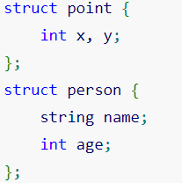
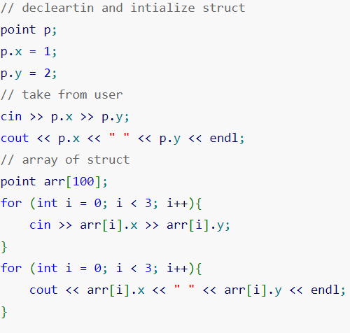
Struct

Slide 21
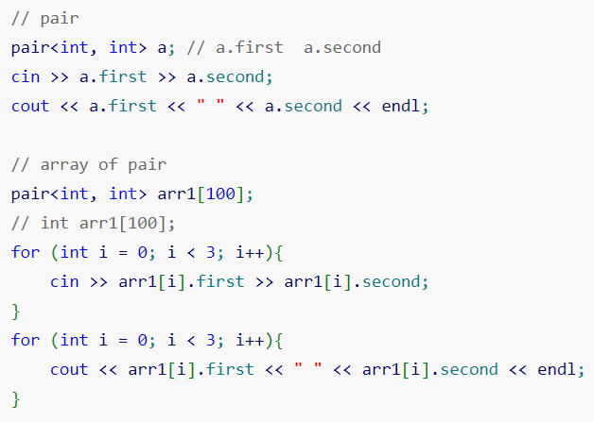
pair

Slide 22
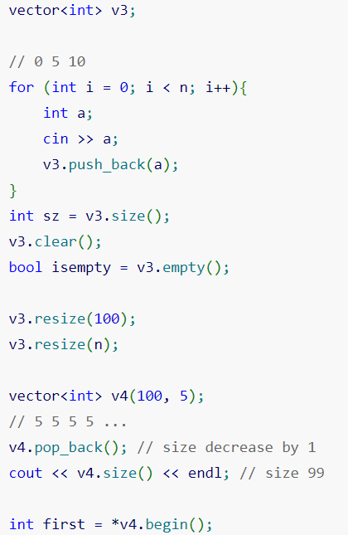
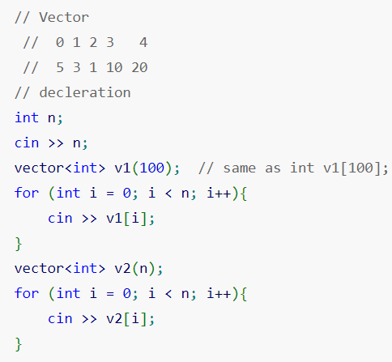
vector

Slide 23
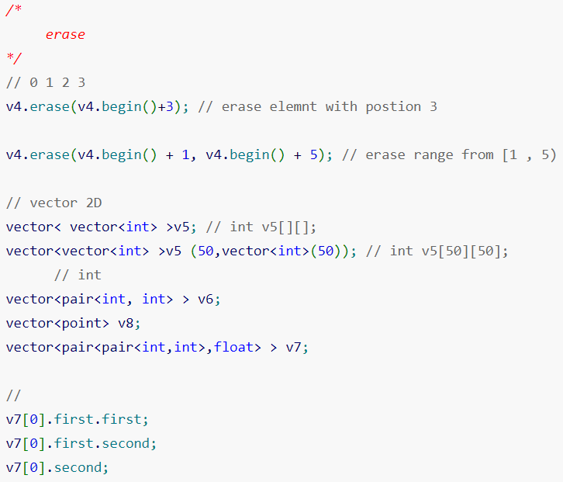
vector erase

Slide 24
Ten uses for pen (break)

Slide 25
Prefix sum
Range Query on arrays 1D.
Range update L , R by X.
2D Sum Queries ( Rectangle)
Solve This Problems Link 1 , Link 2 , Link 3

Slide 26
Prefix sum
It is a simple yet powerful technique that allows to perform fast calculation on the sum of elements in a given range (called contiguous segments of array).

Slide 27
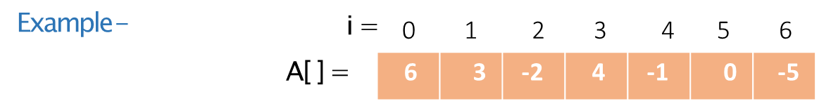
Prefix sum
It is a simple yet powerful technique that allows to perform fast calculation on the sum of elements in a given range (called contiguous segments of array).

Slide 28
Prefix sum
It is a simple yet powerful technique that allows to perform fast calculation on the sum of elements in a given range (called contiguous segments of array).

Slide 29
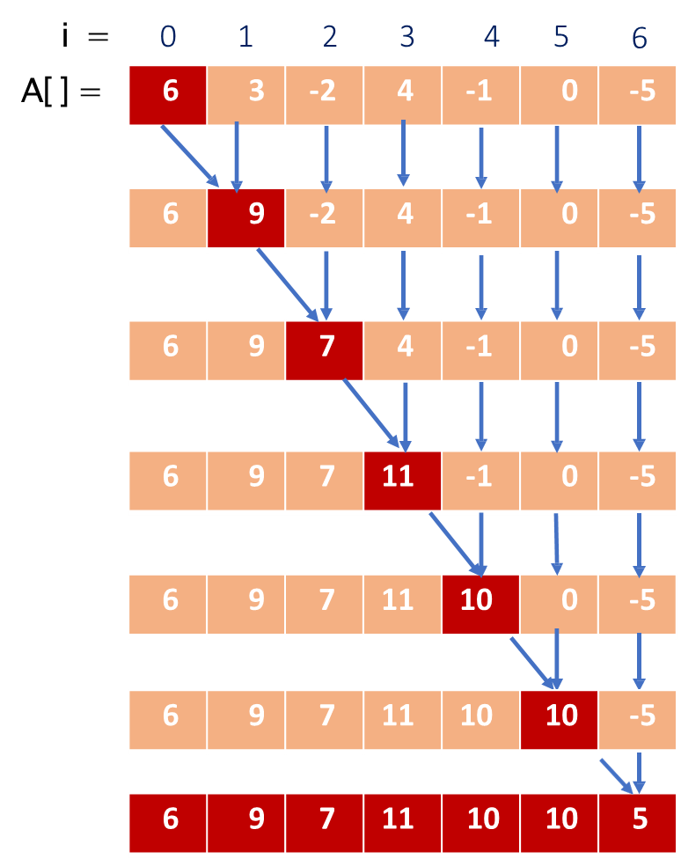
Prefix sum

Slide 30
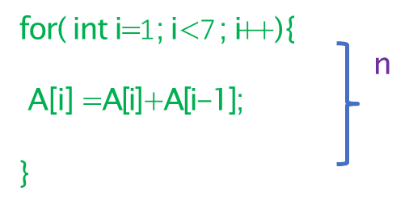
Prefix sum

Slide 31

Prefix sum
6 | 3 | -2 | 4 | -1 | 0 | -5
Prefix Sum Array -
i =
A[ ] =
6 | 9 | 7 | 11 | 10 | 10 | 5

Slide 32
Prefix sum
6 | 3 | -2 | 4 | -1 | 0 | -5
Prefix Sum Array -
i =
A[ ] =
6 | 9 | 7 | 11 | 10 | 10 | 5
Calculate the sum between range [0, 4] ?

Slide 33
Prefix sum
6 | 3 | -2 | 4 | -1 | 0 | -5
Prefix Sum Array -
i =
A[ ] =
6 | 9 | 7 | 11 | 10 | 10 | 5
Calculate the sum between range [0, 4] ?

Slide 34

Prefix sum
6 | 3 | -2 | 4 | -1 | 0 | -5
Prefix Sum Array -
i =
A[ ] =
6 | 9 | 7 | 11 | 10 | 10 | 5
Calculate the sum between range [0, 4] ?

Slide 35

Prefix sum
6 | 3 | -2 | 4 | -1 | 0 | -5
Prefix Sum Array -
i =
A[ ] =
6 | 9 | 7 | 11 | 10 | 10 | 5
Calculate the sum between range [0, 4] ?

Slide 36
Prefix sum
6 | 3 | -2 | 4 | -1 | 0 | -5
Prefix Sum Array -
i =
A[ ] =
6 | 9 | 7 | 11 | 10 | 10 | 5
Calculate the sum between range [0, 4] ?

Slide 37
Prefix sum
6 | 3 | -2 | 4 | -1 | 0 | -5
Prefix Sum Array -
i =
A[ ] =
6 | 9 | 7 | 11 | 10 | 10 | 5
Calculate the sum between range [0, 4] ?
^{Ans : 5 (=A[6])} O(1)

Slide 38
Prefix sum
Calculate the sum between range [2, 6] ?
6 | 3 | -2 | 4 | -1 | 0 | -5
Prefix Sum Array -
i =
A[ ] =
6 | 9 | 7 | 11 | 10 | 10 | 5
Calculate the sum between range [0, 4] ?
^{Ans : 5 (=A[6])} O(1)

Slide 39
Prefix sum
Calculate the sum between range [2, 6] ?
sum between range [0, 6]
6 | 3 | -2 | 4 | -1 | 0 | -5
Prefix Sum Array -
i =
A[ ] =
6 | 9 | 7 | 11 | 10 | 10 | 5
Calculate the sum between range [0, 4] ?
^{Ans : 5 (=A[6])} O(1)

Slide 40
Prefix sum
Calculate the sum between range [2, 6] ?
sum between range [0, 6]
6 | 3 | -2 | 4 | -1 | 0 | -5
sum between range [0, 6] =
sum between range [0, 1] +
sum between range [2, 6]
Prefix Sum Array -
i =
A[ ] =
6 | 9 | 7 | 11 | 10 | 10 | 5
Calculate the sum between range [0, 4] ?
^{Ans : 5 (=A[6])} O(1)

Slide 41
Prefix sum
Calculate the sum between range [2, 6] ?
sum between range [0, 6]
6 | 3 | -2 | 4 | -1 | 0 | -5
sum between range [0, 6] =
sum between range [0, 1] +
sum between range [2, 6]
Prefix Sum Array -
i =
A[6] = A[1] + sum between range [2, 6]
A[6] - A[1] = sum between range [2, 6]
A[ ] =
6 | 9 | 7 | 11 | 10 | 10 | 5
Calculate the sum between range [0, 4] ?
^{Ans : 5 (=A[6])} O(1)

Slide 42
Prefix sum
Calculate the sum between range [2, 6] ?
sum between range [0, 6]
6 | 3 | -2 | 4 | -1 | 0 | -5
sum between range [0, 6] =
sum between range [0, 1] +
sum between range [2, 6]
Prefix Sum Array -
i =
A[6] = A[1] + sum between range [2, 6]
A[6] - A[1] = sum between range [2, 6]
A[ ] =
6 | 9 | 7 | 11 | 10 | 10 | 5
Calculate the sum between range [0, 4] ?
sum between range [2, 6] = A[6] - A[1]
sum between range [2, 6] = 5 - 9
sum between range [2, 6] = - 4
^{Ans : 5 (=A[6])} O(1)

Slide 43
Prefix sum
6 3
-2 4 -1 0
-5
 | A[2, 6]
i =
A[ ] =
0
1
2
3
4 5
6
6 | 9 | 7 | 11 | 10 | 10 | 5

Slide 44
Prefix sum
6 3
-2 4 -1 0
A[2, 6]
-5
A[6]
6
A[1]
1
i =
A[ ] =
0
2
3
4 5
6 | 9 | 7 | 11 | 10 | 10 | 5

Slide 45
Prefix sum
6 3
-2 4 -1 0
A[2, 6]
-5
A[2, 6] =
A[6] ^{- A[1]}
A[6]
6
A[1]
1
i =
A[ ] =
0
2
3
4 5
6 | 9 | 7 | 11 | 10 | 10 | 5

Slide 46
Prefix sum
6 3
-2 4 -1 0
A[2, 6]
-5
A[2, 6] =
A[6] ^{- A[1]}
A[6]
6
A[1]
1
i =
A[ ] =
0
2
3
4 5
6 | 9 | 7 | 11 | 10 | 10 | 5
To calculate the sum between range [I, j]
Formula -

Slide 47
Prefix sum
6 3
-2 4 -1 0
A[2, 6]
-5
A[2, 6] =
A[6] ^{- A[1]}
A[6]
6
A[1]
1
i =
A[ ] =
0
2
3
4 5
6 | 9 | 7 | 11 | 10 | 10 | 5
To calculate the sum between range [I, j]
A[j] - A[i - 1]
A[i, j] =
Formula -

Slide 48
Prefix sum
6 3
-2 4 -1 0
A[2, 6]
-5
A[2, 6] =
A[6] ^{- A[1]}
A[6]
6
A[1]
1
i =
A[ ] =
0
2
3
4 5
6 | 9 | 7 | 11 | 10 | 10 | 5
Calculate the sum between range [3, 5] ?
To calculate the sum between range [I, j]
A[j] - A[i - 1]
A[i, j] =
Formula -

Slide 49
Prefix sum
6 3
-2 4 -1 0
A[2, 6]
-5
A[2, 6] =
A[6] ^{- A[1]}
A[6]
6
A[1]
1
i =
A[ ] =
0
2
3
4 5
6 | 9 | 7 | 11 | 10 | 10 | 5
Calculate the sum between range [3, 5] ?
A[3, 5] =
A[3, 5] =
A[3, 5] =
A[3, 5] =
A[5] ^{- A[3 - 1]}
A[5] ^{- A[2]}
10 ⁻ ⁷
3
To calculate the sum between range [I, j]
A[j] - A[i - 1]
A[i, j] =
Formula -

Slide 50
Prefix sum
6 3
-2 4 -1 0
A[2, 6]
-5
A[2, 6] =
A[6] ^{- A[1]}
A[6]
6
A[1]
1
i =
A[ ] =
0
2
3
4 5
6 | 9 | 7 | 11 | 10 | 10 | 5
Calculate the sum between range [3, 5] ?
A[3, 5] =
A[3, 5] =
A[3, 5] =
A[3, 5] =
A[5] ^{- A[3 - 1]}
A[5] ^{- A[2]}
10 ⁻ ⁷
3
To calculate the sum between range [I, j]
O(1)
A[j] - A[i - 1]
A[i, j] =
Formula -

Slide 51
Analysis of Algorithm
To calculate prefix sum array of n size array
Time complexity - O(n)
Time taken to perform range sum query is -
Time complexity - O(1)
Total time taken to pre process the n size array and to perform range query is -
Time complexity -
O(n) + O(1)
~ O(n)

Slide 52

Sharshabeel Problems

Slide 53
Sharshabeel Problems (1)
Given an string and Q queries
For every Query L , R print occurrences of ‘a’ in this range.

Slide 54
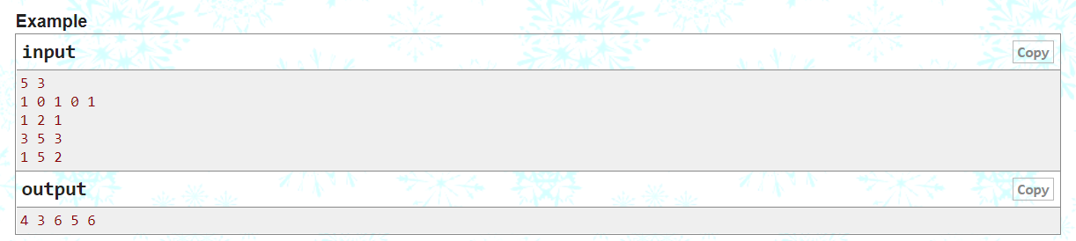
Sharshabeel Problems (2)
you have an array a of size n, and you need to answer q queries. each query need you to add the val to all numbers from index L to index R.
(1≤n,q≤1e5) … ai(0≤a[i]≤1e9).

Slide 55
2D PrefixSum update
Accumulate each row
Accumulate each column
1 | 2 | 2 | 4 | 1
3 | 4 | 1 | 5 | 2
2 | 3 | 3 | 2 | 4
4 | 1 | 5 | 4 | 6
6 | 3 | 2 | 1 | 3
1 | 3 | 5 | 9 | 10
3 | 7 | 8 | 13 | 15
2 | 5 | 8 | 10 | 14
4 | 5 | 10 | 14 | 20
6 | 9 | 11 | 12 | 15
1 | 3 | 5 | 9 | 10
4 | 10 | 13 | 22 | 25
6 | 15 | 21 | 32 | 39
10 | 20 | 31 | 46 | 59
16 | 29 | 42 | 58 | 74

Slide 56
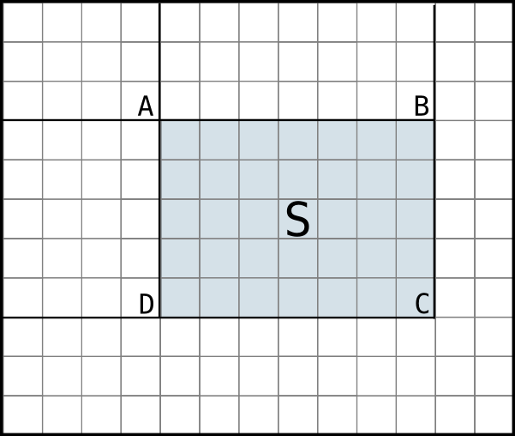
2D PrefixSum
S = C - B - D + A

Slide 57
2D PrefixSum
S = C - B - D + A
X = (i, j)
A = (i-1, j-1)
B = (i-1, L)
A = (k, j-1)
C = (k, L)

Slide 58
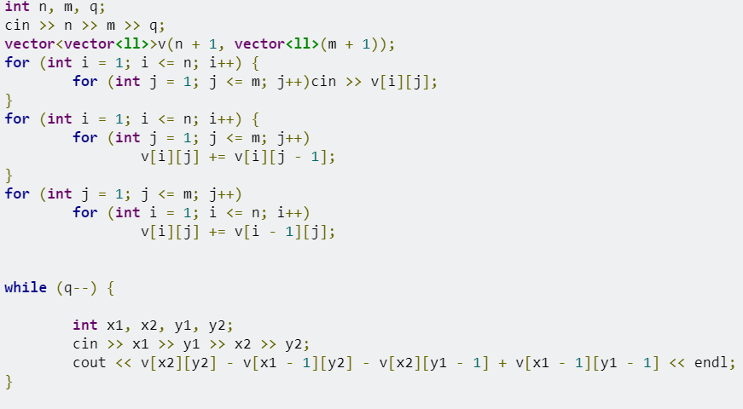

2D PrefixSum
Accumulate each column

Slide 59
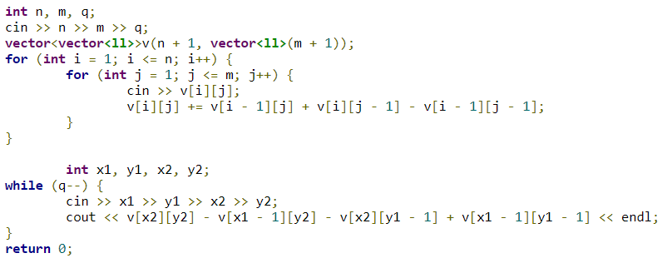
2D PrefixSum

Slide 60
Ad hoc Problems
made or happening only for a particular purpose , not planned before it
Ad Hoc problems are problems that cannot be classified anywhere else.
need to think more , write code less.

Slide 61

اني كويسشنززز؟!!

